Slide 1
CHATBOTS
Swami Amit Bandu
amit.swami.comp.2021@vpkbiet.org
Department of Computer Engineering, Vidya Pratishthans College of Engineering Vidyanagari, Baramati-413133

Slide 2
Introduction
Introduction
In Today world, Chatbot plays an important role in people life. It is used in communication or interaction purpose with human.
Due to the existence of Natural language interaction between humans and computers, chatbot is very useful for humans.
It also helps to learn, think, behave and communicate like humans and able to solve the problems.
Chatbot is classified into two types as web Chabot and standalone chatbot.
Seminar Short Title

Slide 3
Due to the advancement developed in the field of machine learning algorithms and deep learning applications combined with the artificial intelligence, they have dominated human works.
Chatbots are feed with some kind of information like human intelligence for seeking correct information when user asks for queries
Most of the chatbots works on a basic model of these three properties namely: 1. Entities 2. Intents 3. Responses
Seminar Short Title

Slide 4
Problem Statement
A Chatbot that can handle customer inquiries and support requests efficiently across various industries.
Chatbots in enhancing the customer shopping experience, providing product recommendations, and resolving inquiries in the e-commerce industry.
A Chatbot that serves as a virtual tutor, helping students with their homework and providing explanations for various subjects.
A Chatbot that can translate conversations in real-time between multiple languages.
Seminar Short Title

Slide 5
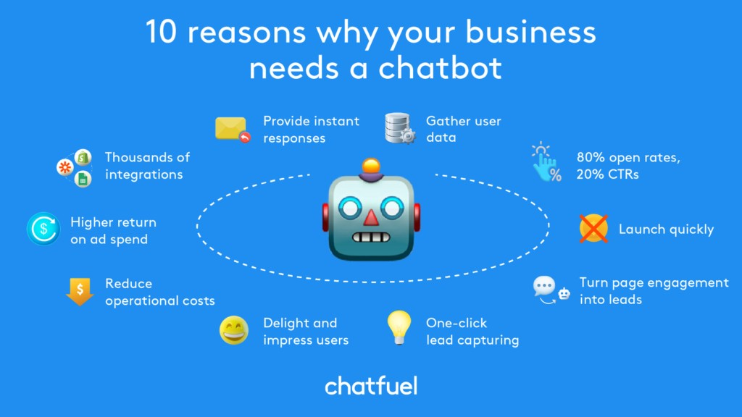
Applications
Seminar Short Title

Slide 6
Literature Survey
The author John P. Mclntire, Lindsey K. Mclntire, Paul R. Havig has provided a survey on the chatbot which provides service to users that people use to communicate with the system through a chatbot interface or client side application.
The authors Sameera A. Abdul-Kader, Dr. John Woods proposed a survey paper including the various design framework of the chatbot with the speciality of conversation done through the speech also.
Seminar Short Title

Slide 7
Algorithms/Methods/Technology
Na¨ıve Bayes Algorithm Support vector Machine Natural language processing (NLP) Recurrent neural networks (RNN) Long short-term memory (LSTM) Markov models for text generation Grammar and Parsing Algorithms
Seminar Short Title

Slide 8
Comparision of the Methods/Technology
Rule-Based Chatbots:
Pattern Matching: Rule-based chatbots use predefined rules and patterns to match user input and generate responses. These rules can be based on keywords, regular expressions, or simple if-else statements.
Decision Trees: Chatbots can use decision trees to make responses based on user inputs, following a predefined branching structure.
Machine Learning-Based Chatbots:
Intent Recognition: Machine learning models, such as logistic regression, support vector machines, or neural networks, can be used to classify user intents based on training data.
Response Generation: Sequence-to-sequence models, like LSTM or transformer-based models (e.g., GPT-3), can be employed to generate responses based on user inputs.
Seminar Short Title

Slide 9
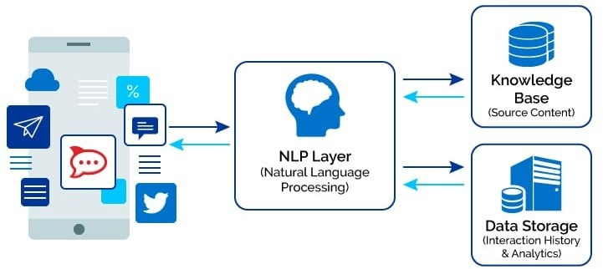
Layout
Seminar Short Title

Slide 10
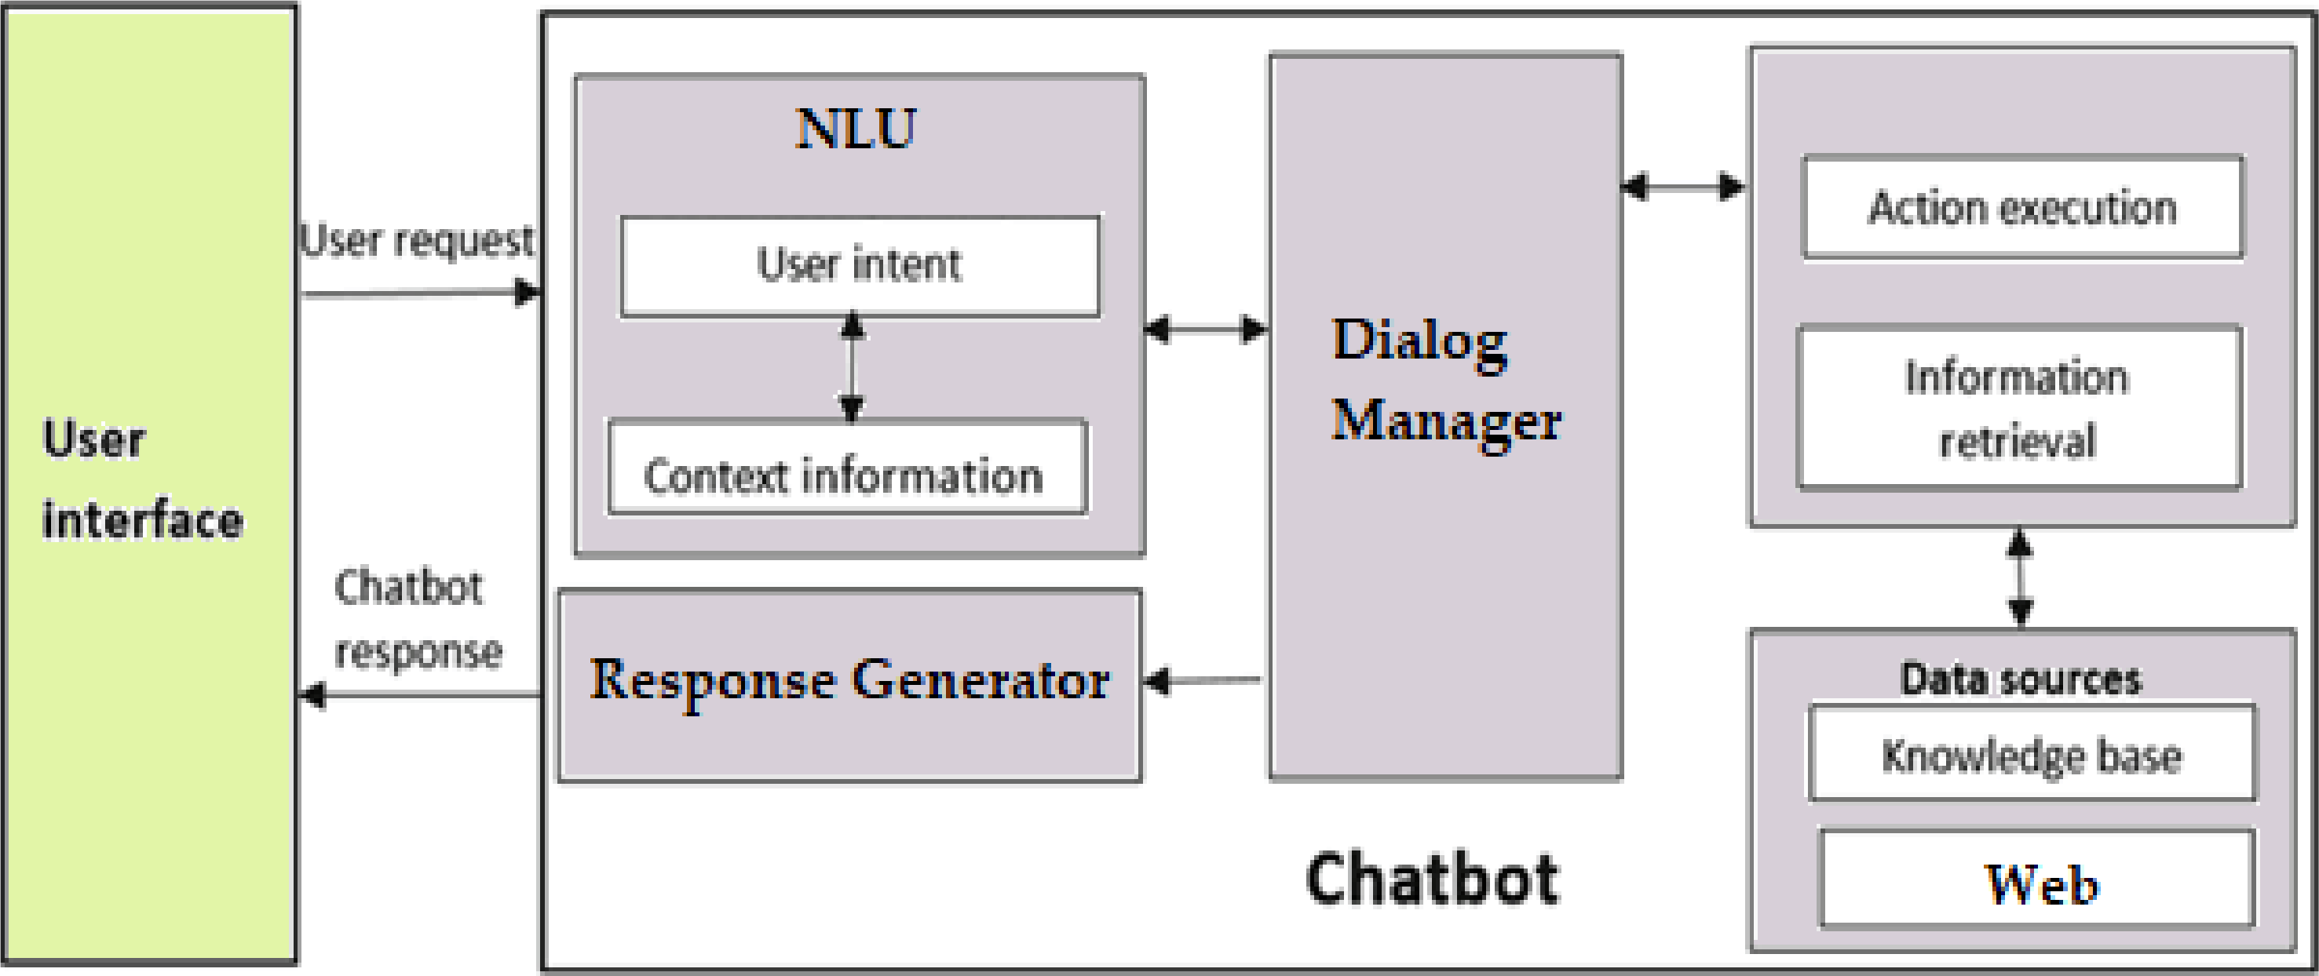
Working
Seminar Short Title

Slide 11
Conclusion
Thus, by concluding, this seminar presentation provides a clear picture of Chatbots, their applications and how it can be built. Though there are different application based chatbots it can be integrated with all kinds of services for the users. Thus from the above survey, we can easily conclude that the chatbot has been playing a major part of role in recent years almost all fields like education, transportation, medicine, etc. Also, it is developed with various design techniques based on the services to be provided by it for users and it is using different algorithms at the backend or depends up on the different design platforms provided for it. We will get to know more about them in coming years!
Seminar Short Title

Slide 12
References
S. Meshram, N. Naik, M. VR, T. More and S. Kharche, ”Conversational AI: Chatbots,” 2021 International Conference on Intelligent Technologies (CONIT), Hubli, India, 2021, pp. 1-6, doi: 10.1109/CONIT51480.2021.9498508.
A. Mondal, M. Dey, D. Das, S. Nagpal and K. Garda, ”Chatbot: An automated conversation system for the educational domain,” 2018 International Joint Symposium on Artificial Intelligence and Natural Language Processing (iSAI-NLP), Pattaya, Thailand, 2018, pp. 1-5, doi: 10.1109/iSAI-NLP.2018.8692927..
A. Savanur, N. M, A. M P and D. P, ”Application of Chatbot for consumer perspective using Artificial Intelligence,” 2021 6th International Conference on Communication and Electronics Systems (ICCES), Coimbatre, India, 2021, pp. 1479-1483, doi: 10.1109/ICCES51350.2021.9488990.
Seminar Short Title

Slide 13

Thanking You Slide
Seminar Short Title

Slide 14
The End
Seminar Short Title

